Slide 1
Introduction to Market Structures
Module 4 · Video 1
Management 405
Prof. Nico Voigtländer · UCLA Anderson

Slide 2
Competitive Markets and Market Interventions
Module 4
Management 405
Prof. Nico Voigtländer · UCLA Anderson

Slide 3
Module 4 · Video 1 · Logistics
Some Logistics
Coffee & Econ office hours restart next week
Final exam period: December 11 – 13, 2026
One 3.5-hour window — the same window for everyone
The exact date and time will be announced later
Online, open book, open notes; covers all material
Management 405 · Module 4 · Competitive Markets and Market Interventions
3
Notes:
A few housekeeping points before we start. The problem set for this module is on BruinLearn, and the practice videos are there too. Everything we do today builds on the cost curves from Module 3, so keep those handy.

Slide 4
Module 4 · Video 1 · Course Roadmap
Agenda for the Class
1. Basic Principles and Economic Way of Thinking
2. Value and Demand
3. Supply and Cost
4. Markets, Pricing, and Strategy
we are here
Management 405 · Module 4 · Competitive Markets and Market Interventions
4

Slide 5
Module 4 · Video 1 · Agenda
Outline of Module 4
1
Introduction to Market Structures
Where a firm sits between price taker and price setter
Video 1
2
Perfect Competition
Many small sellers, an identical product, and free entry
Video 2
2a
Profit Maximization of a Price Taker in the Short Run
How much to produce, and when to stop production
Video 3
2b
Firm-Level and Market Supply
Marginal cost is one firm’s supply curve; market supply sums across firms
Video 4
2c
Long-Run Competitive Equilibrium
Entry and exit drive economic profits to zero
Video 5
3
Market Distortions and Regulations
Who wins, who loses, and what is lost outright
In Class
4
Externalities
Costs and benefits that land on people outside the deal
In Class
Management 405 · Module 4 · Competitive Markets and Market Interventions
5

Slide 6
Module 4 · Video 1 · Agenda
Outline of Module 4
1
Introduction to Market Structures
Where a firm sits between price taker and price setter
Video 1
2
Perfect Competition
Video 2
2a
Profit Maximization of a Price Taker in the Short Run
Video 3
2b
Firm-Level and Market Supply
Video 4
2c
Long-Run Competitive Equilibrium
Video 5
3
Market Distortions and Regulations
In Class
4
Externalities
In Class
Management 405 · Module 4 · Competitive Markets and Market Interventions
6

Slide 7
Module 4 · Video 1 · Introduction to Market Structures
The Four Basic Market Structures
 | Perfect Competition | Monopolistic Competition | Oligopoly | Monopoly
Number of firms | Many | Many | Few | One
Type of products sold | Identical | Differentiated | Identical or Differentiated | “Unique”
Barriers to entry | None | None | Some | Many
More firms, more similar products, easier entry → more competition
Management 405 · Module 4 · Competitive Markets and Market Interventions
7
Notes:
Here we start thinking about a firm’s competitive environment or market structure. We categorize market structure using three characteristics:
1. Number of firms: in general, when there are more companies in the market, the market is more competitive.
2. Whether the consumer cares which company made the good: are the goods identical or can the consumer distinguish who made the good? In general, if goods are closer to identical, the market is more competitive.
3. Barriers to entry: if new firms can enter the market easily, the market is more competitive.

Slide 8
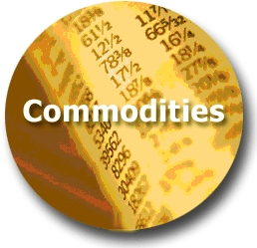




Module 4 · Video 1 · Introduction to Market Structures
Extent of Market Power: Price Takers vs. Price Searchers
Least Market Power
Most Market Power
Perfect Competition
Monopolistic Competition
Oligopoly
Monopoly
(Price Takers)
(Price Searchers)
Commodity markets
Restaurants in WeHo
Wide-body aircraft
Municipal utilities
TODAY
Management 405 · Module 4 · Competitive Markets and Market Interventions
8
Notes:
Extent of market power. The spectrum runs from price taker (today’s topic) to price searchers with increasing degrees of market power (subject of subsequent sessions):
A perfectly competitive firm has no market power; it has such a small percentage of the market that it can exert no effect on price.
A monopolistically competitive firm, such as gas stations and restaurants, offers a differentiated product and thus faces a downward sloping demand curve – offerings of other firms are not perfect substitutes. There is still intense competition because the products can substitute for each other so the elasticity of demand facing each firm tends to be high. Free entry drives long-run profits to zero.
Oligopolistic markets are cases of few firms. For example, a duopoly is a special case of an oligopoly with only 2 firms. Interesting strategic issues arise here as you need to think hard about your rivals’ response to your firm’s behavior. Entry may be limited.
Monopolistic markets are markets with only one seller, such as utilities in most cities (legal monopoly) or Microsoft (quasi-monopoly, due to demand-side economies of scale, i.e. network effects).

Slide 9
Perfect Competition
Module 4 · Video 2
Management 405
Prof. Nico Voigtländer · UCLA Anderson

Slide 10
Module 4 · Video 2 · Agenda
Outline of Module 4
1
Introduction to Market Structures
Video 1
2
Perfect Competition
Many small sellers, an identical product, and free entry
Video 2
2a
Profit Maximization of a Price Taker in the Short Run
Video 3
2b
Firm-Level and Market Supply
Video 4
2c
Long-Run Competitive Equilibrium
Video 5
3
Market Distortions and Regulations
In Class
4
Externalities
In Class
Management 405 · Module 4 · Competitive Markets and Market Interventions
10

Slide 11
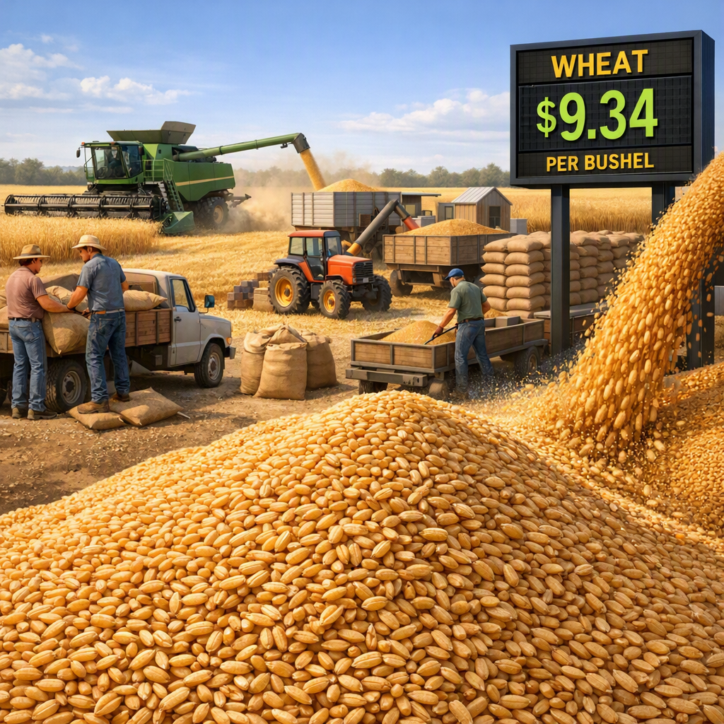
Module 4 · Video 2 · Perfect Competition
Perfect Competition: The Price Taker
 | Perfect competition — price takers
Number of actual or potential competitors | Many small sellers
Product differentiation | None
Entry conditions | No barriers
Profit potential | Short run: can be positive, negative or zero Long run: zero economic profit
Examples | Agricultural commodities; currency markets; unskilled labor
Management 405 · Module 4 · Competitive Markets and Market Interventions
11
Notes:
Characteristics of a price taker market. Today we focus on perfect competition. For a market to be perfectly competitive, three conditions must be satisfied:
There are many firms. Thus, the impact of any one firm on the market equilibrium is negligible.
All firms produce an identical product.
There are no barriers to entry.
The implications of these conditions is that firms in perfectly competitive markets are price takers, i.e. they do not have discretion over the price to charge. In the case of price takers, they face perfectly elastic demand (horizontal demand curve), there is no product differentiation, and they cannot deviate in price. Examples include Indian rice producers, sellers of currency, etc. If the firm chooses a price above the market price, the firm will lose all sales. Since the firm can sell as much as it would like at the market price, it has no incentive to sell at a quantity below the market price.
Why study perfect competition? There are 3 main reasons:
You need to understand how perfectly competitive markets around you function. For instance, the bond market, the currency markets, commodity markets, labor markets, etc, where price taking behavior is frequent.
You might have to act in perfectly competitive markets on occasion.
By understanding perfect competition in depth you can come up with ways to make the market in which you operate look more like an imperfect competition market. This is what businesses do – differentiate, raise barriers to entry, gain market power.

Slide 12
Module 4 · Video 2 · Perfect Competition
Perfect Competition: The Market and the Firm
Market
Firm (price taker)
Price ($)
Price ($)
Market equilibrium
S
P*
Demand curve d = Marginal Revenue (MR)
P*
D
Quantity
Quantity
Management 405 · Module 4 · Competitive Markets and Market Interventions
12
Notes:
This slides explain the relationship between the market vs. the firm demand. It shows where the demand a price taker is coming from = market price, determined by the market equilibrium.
Now, let’s turn to see how a price taker maximizes profit in the short run.

Slide 13


Module 4 · Video 2 · Perfect Competition
Perfect Competition and Farmer Protests
Germany cut its farm subsidies in 2024
Some farmers stood to lose up to €10,000 a year
“For farmers there is a structural problem: they cannot pass on their production costs, because the prices are not made by them.” — Germany's Minister of Economic Affairs, 2024
Farmer protests in Berlin, January 2024. Photo: The Guardian
Management 405 · Module 4 · Competitive Markets and Market Interventions
13
Notes:
This is the intuition behind price taking. A single wheat farmer who tries to charge more than the going price simply sells nothing, because buyers have thousands of identical alternatives. That is what we mean when we say the firm faces a horizontal demand curve at the market price.

Slide 14
Profit Maximization of a Price Taker
Module 4 · Video 3
Management 405
Prof. Nico Voigtländer · UCLA Anderson

Slide 15
Module 4 · Video 3 · Agenda
Outline of Module 4
1
Introduction to Market Structures
Video 1
2
Perfect Competition
Video 2
2a
Profit Maximization of a Price Taker in the Short Run
How much to produce, and when to stop production
Video 3
2b
Firm-Level and Market Supply
Video 4
2c
Long-Run Competitive Equilibrium
Video 5
3
Market Distortions and Regulations
In Class
4
Externalities
In Class
Management 405 · Module 4 · Competitive Markets and Market Interventions
15

Slide 16
Module 4 · Video 3 · Profit Maximization of a Price Taker in the Short Run
Price Taker Revenue Conditions
Market Price P=$3
Total Revenue
The Firm's Demand
P | Q | TR | MR
$3 | 10 | $30 | $3
3 | 11 | 33 | 3
3 | 12 | 36 | 3
3 | 13 | 39 | 3
TR ($)
P ($)
TR = P · Q
36
30
d = P = MR
3
Selling one more unit always brings in the same $3, so MR = P at every quantity
10
12
Quantity
Quantity
Management 405 · Module 4 · Competitive Markets and Market Interventions
16
Notes:
For a price taker, revenue is simple: every extra unit sells at the same market price, so marginal revenue equals that price and never falls. This is the one case where MR = P, and it is why the profit-maximising rule collapses to P = MC. Keep that in mind, because it will not hold once we get to firms with market power.

Slide 17

Module 4 · Video 3 · Profit Maximization of a Price Taker in the Short Run
Price Taker Profit Maximization
Set MR = MC — the rule for every profit maximizer
But MR is far easier to "compute" for a price taker
For a price taker, MR = P, the market price
P is given: the firm cannot set it
So there is only one decision left: how much to produce
$$Find Q^{∗} such that P = MC$$
➜
Management 405 · Module 4 · Competitive Markets and Market Interventions
17
Notes:
Any perfectly competitive firm sells at the price set by the market. Perfectly competitive firms then have one decision to make: the quantity to supply.

Slide 18

Module 4 · Video 3 · Profit Maximization of a Price Taker in the Short Run
Profit Maximization of a Price Taker: Visual Representation
Firm revenue, cost and profit ($)
TC
(TR has constant slope for a price taker)
TR
Slope of TR = slope of TC: MR = MC
Profit = 0
Maximum profit
TFC
Quantity (Q)
Q*
Profit $π$
Profit = TR − TC Widest where the two slopes are equal (MR = MC)
Management 405 · Module 4 · Competitive Markets and Market Interventions
18
Notes:
Here is profit maximisation seen through totals rather than margins. Total revenue is a straight line because price is constant; total cost rises and then curves up as diminishing returns bite. Profit is the vertical gap between them, and it is widest exactly where the two curves are parallel - which is the same thing as saying marginal revenue equals marginal cost.

Slide 19

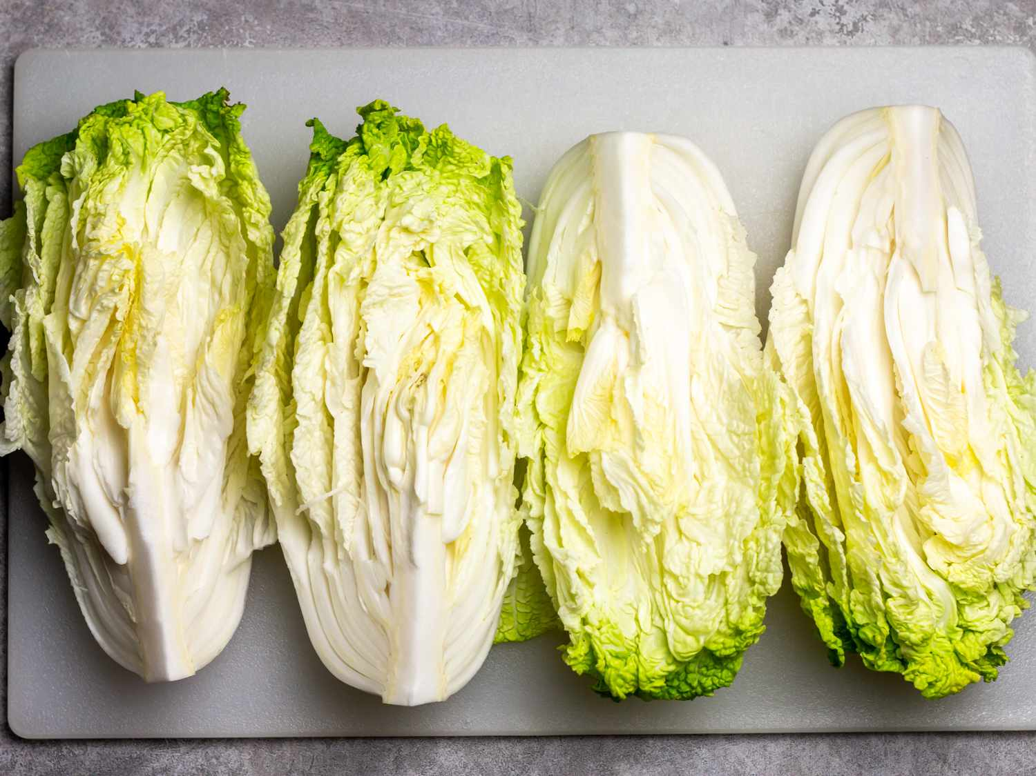
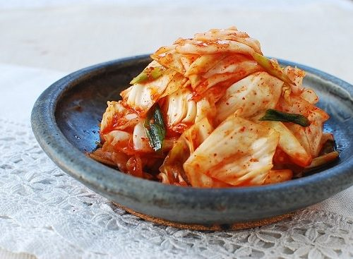
Module 4 · Video 3 · Profit Maximization of a Price Taker in the Short Run
Example: The Yi Family
A South Korean family moves from California to rural Arkansas to start a farm
Their goal: grow Korean produce and sell it to vendors in Dallas, at the market price
We follow their cabbage crop — the raw material for kimchi
Minari (2020)
🎬 Yi Family Example
Management 405 · Module 4 · Competitive Markets and Market Interventions
19
Notes:
Meet the Yi family. They have moved from California to rural Arkansas to grow Korean cabbage and sell it to vendors in Dallas at whatever the market price happens to be. We will follow their cabbage crop for the rest of this section, so every abstract rule gets tested against a real set of numbers.
https://www.vulture.com/article/minari-movie-review-a-gentle-immigrant-drama-set-in-u-s.html
https://time.com/5938842/minari-korean-american-farmers/

Slide 20
Module 4 · Video 3 · Profit Maximization of a Price Taker in the Short Run
Business Relevance
Key questions:
Should the Yi family produce at all?
1
How much should they produce?
2
We start with the second question: profit maximization
Key concept: marginal analysis
🎬 Yi Family Example
Management 405 · Module 4 · Competitive Markets and Market Interventions
20
Notes:
Why this matters to you as a manager: almost no business is a textbook price taker, but many face something close to it in at least one market - a commodity input, a contract-manufacturing line, a spot market. The discipline of asking what you can and cannot influence about your price is the useful part.
In bullet number 2: emphasize that no price decision since we are price takers

Slide 21


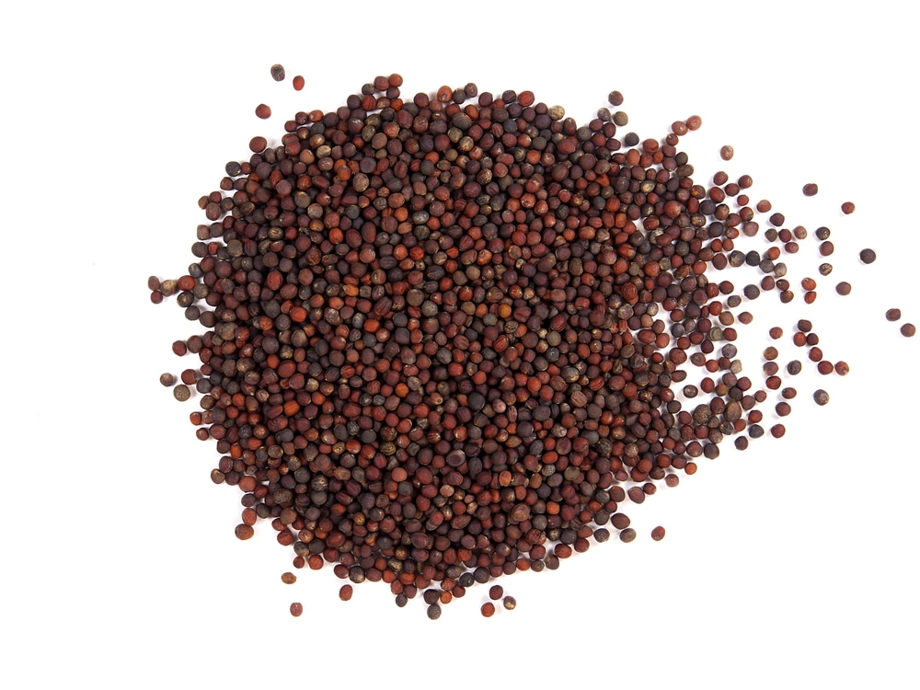
Module 4 · Video 3 · Profit Maximization of a Price Taker in the Short Run
Cabbage Production Costs
Q (tons) | TC | TFC | TVC
50 | 67,250 | 60,000 | 7,250
200 | 95,000 | 60,000 | 35,000
400 | 146,000 | 60,000 | 86,000
600 | 213,000 | 60,000 | 153,000
800 | 296,000 | 60,000 | 236,000
1,000 | 395,000 | 60,000 | 335,000
Fixed costs: land rent, equipment, and the salary the family gives up (opportunity cost)
Variable costs: seeds, water, fertilizer, pesticides, fuel…
Seeds · irrigation · fertilizer
🎬 Yi Family Example
Management 405 · Module 4 · Competitive Markets and Market Interventions
21
Notes:
Source for the costs: https://ucanr.edu/sites/Farm_Management/files/179212.pdf
Opportunity costs: salary from working somewhere else, estimated at about 15k
Quantity in tons
Fixed Costs: land rent, equipment + opportunity costs
Variable Costs: seeds, water, fertilizers, pesticides
Images: right (water), top left (fertilizers), bottom left (seeds)

Slide 22
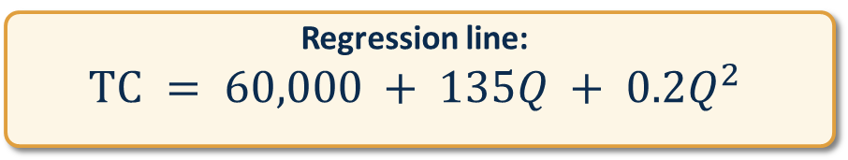
Module 4 · Video 3 · Profit Maximization of a Price Taker in the Short Run
Cabbage Total Cost Function
Regression line:
$$TC = 60,000 + 135Q + 0.2Q^{2}$$
Q (tons) | TC ($)
50 | 67,250
200 | 95,000
400 | 146,000
600 | 213,000
800 | 296,000
1,000 | 395,000
Total cost ($)
400,000
300,000
200,000
100,000
200
400
600
800
1,000
Quantity (tons)
🎬 Yi Family Example
Management 405 · Module 4 · Competitive Markets and Market Interventions
22
Notes:
This is the Yi family's cost function. The fixed cost of 60,000 dollars is the land and equipment they are committed to for the season. The variable part rises more than proportionally with output, which is exactly the diminishing returns we saw in Module 3 showing up in dollars.
Source for the costs: https://ucanr.edu/sites/Farm_Management/files/179212.pdf
Opportunity costs: salary from working somewhere else, estimated at about 15k

Slide 23
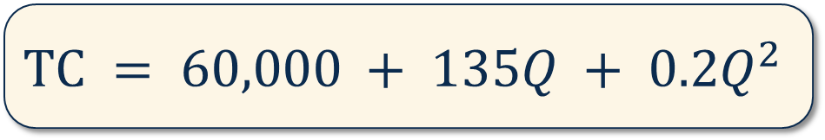

Module 4 · Video 3 · Profit Maximization of a Price Taker in the Short Run
Maximizing Profit: Cabbage Production
The Yi family has estimated its total cost:
$$TC = 60,000 + 135Q + 0.2Q^{2}$$
Q is the quantity produced, in tons
The market price of cabbage is:
$$P = \$400 per ton$$
How many tons should the Yi family produce to maximize profits?
🎬 Yi Family Example
Management 405 · Module 4 · Competitive Markets and Market Interventions
23
Notes:
Market price: $400 per ton is about $20 per cwt, which is the USDA season-average price for fresh-market cabbage in 2020. Recent years run higher — $31.10 per cwt in 2024.
https://www.agmrc.org/commodities-products/vegetables/cabbage

Slide 24
Module 4 · Video 3 · Profit Maximization of a Price Taker in the Short Run
POLL
Management 405 · Module 4 · Competitive Markets and Market Interventions
24

Slide 25

Module 4 · Video 3 · Profit Maximization of a Price Taker in the Short Run
Profit-Maximizing Quantity: Solution
We need to set MR = MC
MC is the derivative of TC with respect to Q, with $TC = 60,000 + 135Q + 0.2Q^{2}$
$$MC = \frac{dTC}{dQ} = 135 + 0.4Q$$
The cabbage market is competitive, so MR is just the market price:
$$MR = P = 400$$
MR = MC thus implies:
$$135 + 0.4Q = 400$$
Solve for Q* (the optimal production)
$$Q^{∗} = 662.5 tons$$
🎬 Yi Family Example
Management 405 · Module 4 · Competitive Markets and Market Interventions
25
Notes:
Work through the algebra with me. Marginal cost is the derivative of total cost, we set it equal to the market price, and we solve for quantity. The answer is the only output level at which the family cannot do better by producing one more or one less ton.

Slide 26
Module 4 · Video 3 · Profit Maximization of a Price Taker in the Short Run
Profit at Q*: Solution
What is the economic profit at the profit-maximizing output level (Q* = 662.5) ?
$$Profit: π = TR − TC$$
$$TR = P · Q = 400 · 662.5 = 265,000$$
$$TC = 60,000 + 135 · 662.5 + 0.2 · {662.5}^{2} = 237,218.75$$
$$Profit: π = 265,000 − 237,218.75 = 27,781.25$$
The Yi family makes a positive economic profit at Q*
🎬 Yi Family Example
Management 405 · Module 4 · Competitive Markets and Market Interventions
26
Notes:
Now the profit itself. We take the optimal quantity, compute total revenue and total cost at that quantity, and take the difference. Notice that the answer is positive here - that will not always be the case, and the rest of this section is about what to do when it is not.

Slide 27


Module 4 · Video 3 · Profit Maximization of a Price Taker in the Short Run
Profits and Average Total Costs (ATC)
$$Profit: π = TR − TC$$
$$π= (P · Q) − (ATC · Q)$$
$$π= (P − ATC) · Q$$
$$where ATC = \frac{TC}{Q} (average total cost per ton)$$
$$Profit is positive if P ≥ ATC$$
Management 405 · Module 4 · Competitive Markets and Market Interventions
27
Notes:
Average total cost is the second lens on the same problem. Total cost divided by quantity tells you what each ton costs on average, and comparing that to the price tells you immediately whether you are making money. It is the version of the calculation that most managers actually carry in their head.

Slide 28


Module 4 · Video 3 · Profit Maximization of a Price Taker in the Short Run
Illustrating Positive Profits of the Yi Family
P
MC
$$MC = 135 + 0.4Q$$
P = MR
400
358
Profit
ATC
$$Profit = (P − ATC) · Q^{∗}$$
where ATC is evaluated at the optimal point Q*
135
Q* = 662.5
Quantity (tons)
🎬 Yi Family Example
Management 405 · Module 4 · Competitive Markets and Market Interventions
28
Notes:
This is the picture behind the arithmetic. The height of the shaded box is price minus average total cost - the profit on each ton - and the width is the number of tons. Multiply the two and you have total profit, which is why the box is the profit.

Slide 29
Module 4 · Video 3 · Profit Maximization of a Price Taker in the Short Run
Relationship to Accounting: Ross Stores Annual Report
 | Economic cost concept | Year ended Jan 29, 2022 | Year ended Jan 30, 2021
Sales |  | 18,916,244 | 12,531,565
Cost of goods sold | ≈ TVC | 13,708,907 | 9,838,574
Selling, general and administrative | Mix of FC & VC | 2,874,469 | 2,503,281
Interest expense (income), net | Part of FC | 74,328 | 83,413
Total costs and expenses | ≈ TC | 16,657,704 | 12,425,268
Ross Stores, Form 10-K, fiscal 2021 · $ thousands
Accounting costs leave out opportunity costs
Management 405 · Module 4 · Competitive Markets and Market Interventions
29
Notes:
Using Ross Stores Annual report for illustration: https://www.sec.gov/ix?doc=/Archives/edgar/data/745732/000074573222000014/rost-20220129.htm#i84f0090916e6417881836bdad18ed609_64
Highlight the 3 items under “costs and expenses”
Costs of goods sold = variable
Selling, general and administrative = a bit of both (sales commissions would be variable but the CEO salary fixed)
Interest expense (the cost of borrowing money) = fixed

Slide 30
Module 4 · Video 3 · Profit Maximization of a Price Taker in the Short Run
Maximizing Profits in the Short Run: The General Case
Profit Levels for Different Market Prices
Positive Profit
Zero Profit
Negative Profit (Loss)
P
MC
P
MC
P
MC
P
d = MR
π > 0
ATC
ATC
ATC
P
d = MR
π < 0
d = MR
P
P > ATC at Q*
P = ATC at Q*
P < ATC at Q*
Q*
Q
Q*
Q
Q*
Q
Management 405 · Module 4 · Competitive Markets and Market Interventions
30
Notes:
To measure profit, we subtract total cost from total revenue.
Profit = TR – TC
We can rewrite this as:
Profit = P*Q – ATC*Q
Profit = (P – ATC)*Q
This formula determines whether the firm has positive, zero, or negative profit.
Positive profit: In this figure, the firm’s total revenue is the area of the rectangle with height P and width Q*. The total cost is the area of the rectangle with the height ATC* and the width Q*. Because total revenue exceeds total costs at Q*, the firm is earning positive profits. This equation tells us that profit is positive when P>ATC at the profit maximizing quantity Q*.
Zero profit: Here P=ATC (=MC). We know that MC intersects ATC at its minimum.
Negative profit: P<ATC

Slide 31

Module 4 · Video 3 · Profit Maximization of a Price Taker in the Short Run
If Profit Is Negative, Should a Firm Stop Production / Shut Down?
“Shutting down” in the long run is different from “Stopping production” in the short run
Short Run Temporarily halt production, with the option to restart later Fixed costs still have to be paid — e.g. a building rent or a business truck lease
Long Run Exit the industry altogether, shut down No further payment of fixed costs — e.g. sell the truck and let the building lease expire
We decompose TC into TVC (Short Run) and TFC (Long Run):
$Short run: Profit = P · Q − \underset{ TC}{\underbrace{TVC − TFC}}$, where $TVC=AVC⋅Q$
$$Profit: π = (P−AVC) · Q − TFC$$
Fixed costs still have to be paid
Management 405 · Module 4 · Competitive Markets and Market Interventions
31
Notes:
Here is the question that trips people up. If profit is negative, should the firm stop? Not necessarily - the fixed costs are owed either way in the short run, so the only question is whether revenue covers the costs that producing actually adds. That is the distinction the next slide makes precise.

Slide 32

Module 4 · Video 3 · Profit Maximization of a Price Taker in the Short Run
The Short Run Decision to Stop Production
In the short run, fixed costs have to be paid even if the firm does not produce
Option 1: continue to produce
Option 2: stop production
$$Profit: π = (P − AVC) · Q − TFC$$
$$Profit: π = − TFC$$
Producing adds (P − AVC) · Q to cover fixed costs
Continue to pay the full fixed costs
Difference in profits when producing:
$$Δπ = Q · (P − AVC)$$
⇒ Rule: Continue to produce if P ≥ AVC · Stop production if P < AVC
Management 405 · Module 4 · Competitive Markets and Market Interventions
32
Notes:
The short-run rule in one line. Compare price to average VARIABLE cost, not to average total cost. If price covers the variable cost of each unit, producing contributes something towards the fixed costs and the firm should keep going; if it does not, producing makes the loss bigger than the fixed costs alone.

Slide 33
Module 4 · Video 3 · Profit Maximization of a Price Taker in the Short Run
Optimizing in the Short Run: A New Market Price
The US starts importing large quantities of cabbage from China
The US market price drops from $400 to $210 per ton
Remember: $TC = 60,000 + 135Q + 0.2Q^{2}$
Questions
1. What quantity should the Yi family now produce?
2. What profit do they make at that quantity?
3. Should they continue to produce in the short run?
🎬 Yi Family Example
Poll Break
Management 405 · Module 4 · Competitive Markets and Market Interventions
33
Notes:
Now the market moves against the Yi family. Cheap Chinese imports push the US price down from 400 to 210 dollars a ton. Work through the three questions with the person next to you before we look at the answer - the numbers are all on the earlier slides.
Questions 2 and 3 solved by instructor

Slide 34
Module 4 · Video 3 · Profit Maximization of a Price Taker in the Short Run
POLL
Management 405 · Module 4 · Competitive Markets and Market Interventions
34

Slide 35
Module 4 · Video 3 · Profit Maximization of a Price Taker in the Short Run
POLL
Management 405 · Module 4 · Competitive Markets and Market Interventions
35

Slide 36
Module 4 · Video 3 · Profit Maximization of a Price Taker in the Short Run
POLL
Management 405 · Module 4 · Competitive Markets and Market Interventions
36

Slide 37
Module 4 · Video 3 · Profit Maximization of a Price Taker in the Short Run
Solution: New Q* and Profit
Question 1: Optimal Quantity
$$MC = MR = P$$
$$135 + 0.4Q = 210 → Q^{∗} = 187.5$$
Question 2: Profits
$$TR = P · Q = 210 · 187.5 = 39,375$$
$$TC = 60,000 + 135 · 187.5 + 0.2 · {187.5}^{2} = 92,343.75$$
$$π = 39,375 − 92,343.75 = −52,968.75$$
At the new price, the Yi family makes a loss at the optimal output level
🎬 Yi Family Example
Poll Break
Management 405 · Module 4 · Competitive Markets and Market Interventions
37
Notes:
The new optimum. Same rule, new price: set marginal cost equal to 210 and solve. The quantity falls, and when we compute profit at that quantity it is now negative - so the interesting question is the one on the next slide.

Slide 38
Module 4 · Video 3 · Profit Maximization of a Price Taker in the Short Run
Solution to Question 3: Decision to Continue Production
$$AVC = \frac{135Q + 0.2Q^{2}}{Q} = 135 + 0.2Q$$
$$AVC at Q^{∗} = 187.5 is 135 + 37.5 = 172.5$$
$$Recall: P = 210$$
$$Thus: P > AVC$$
⇒ Keep producing in the short run
Alternatively, compare the two options directly:
▪ Continue to produce: loss of 52,968.75
▪ Stop production: loss of 60,000, the whole of TFC
🎬 Yi Family Example
Poll Break
Management 405 · Module 4 · Competitive Markets and Market Interventions
38
Notes:
And here is the decision. At the new price the family loses money, but price still exceeds average variable cost, so every ton they sell contributes something towards the land and equipment they are paying for anyway. They should keep producing through the season and reconsider in the long run.

Slide 39
Module 4 · Video 3 · Profit Maximization of a Price Taker in the Short Run
High Price: Positive Profits in the Short Run
P
MC
P high
d = MR
Profit
ATC
AVC
Q*
Q
Optimal output is where MC = MR = P. This occurs at Q*. At that output positive economic profits are being made because P > ATC.
Management 405 · Module 4 · Competitive Markets and Market Interventions
39
Notes:
Recap slides, say that we show them in the general case (MC not linear)
Context: At the beginning can sell at a very high price… Profit maximization in the short run. This figure depicts positive profit in the short run.

Slide 40
Module 4 · Video 3 · Profit Maximization of a Price Taker in the Short Run
High Price: Positive Profits in the Short Run
Example with more complex cost functions
P
MC
P
d = MR
Profit
ATC
AVC
Q*
Q
Optimal output is where MC = MR = P. This occurs at Q*. At that output positive economic profits are being made because P > ATC.
Management 405 · Module 4 · Competitive Markets and Market Interventions
40
Notes:
The same logic on a more realistic cost function, where average variable cost is U-shaped rather than rising throughout. Optimal output is still where marginal cost meets price. Here price sits above average total cost at that quantity, so the shaded rectangle is genuine economic profit.

Slide 41
Module 4 · Video 3 · Profit Maximization of a Price Taker in the Short Run
Low Price: Producing at a Loss in the Short Run
P
MC
ATC
Loss
AVC
P low
d = MR
Q*
Q
Negative economic profits (losses) are being made because P < ATC. But P > AVC → the firm should continue to produce in the short run.
Management 405 · Module 4 · Competitive Markets and Market Interventions
41
Notes:
The general case at a lower price. Q* is still where MC meets P, but now price is below average total cost, so the rectangle is a loss. The firm keeps producing anyway, because price is still above average variable cost.

Slide 42
Module 4 · Video 3 · Profit Maximization of a Price Taker in the Short Run
Low Price: Producing at a Loss in the Short Run
Example with more complex cost functions
P
MC
ATC
P
Loss
AVC
d = MR
Q*
Q
Negative economic profits (losses) are being made because P < ATC. But P > AVC → the firm should continue to produce in the short run.
Management 405 · Module 4 · Competitive Markets and Market Interventions
42
Notes:
The same loss case on the complex cost function. Notice that nothing about the rule changed - only where the price line happens to sit relative to the two average-cost curves.

Slide 43
Module 4 · Video 3 · Profit Maximization of a Price Taker in the Short Run
Very Low Price: Stopping Production in the Short Run
P
MC
ATC
AVC
P very low
d = MR
P < AVC at every output
Q
There is no output at which producing covers variable cost: P < AVC everywhere → the firm should stop production, and its loss is then TFC.
Management 405 · Module 4 · Competitive Markets and Market Interventions
43
Notes:
The lowest price case. Here the price line lies below average variable cost at every output, so there is no quantity at which producing helps. The firm stops production and eats the fixed costs.

Slide 44
Module 4 · Video 3 · Profit Maximization of a Price Taker in the Short Run
Very Low Price: Stopping Production in the Short Run
Example with more complex cost functions
P
MC
ATC
Loss
AVC
P
d = MR
Q*
Q
MC really does run below AVC for a while, so there is a Q* where MC = P. But P < AVC at Q* → producing would lose more than TFC, so the firm stops production.
Management 405 · Module 4 · Competitive Markets and Market Interventions
44
Notes:
And the same conclusion on the complex cost function. Because marginal cost really does dip below average variable cost here, there IS a quantity where MC equals P - but price is still below AVC at that quantity, so producing would lose more than the fixed costs. Stopping is still right.

Slide 45
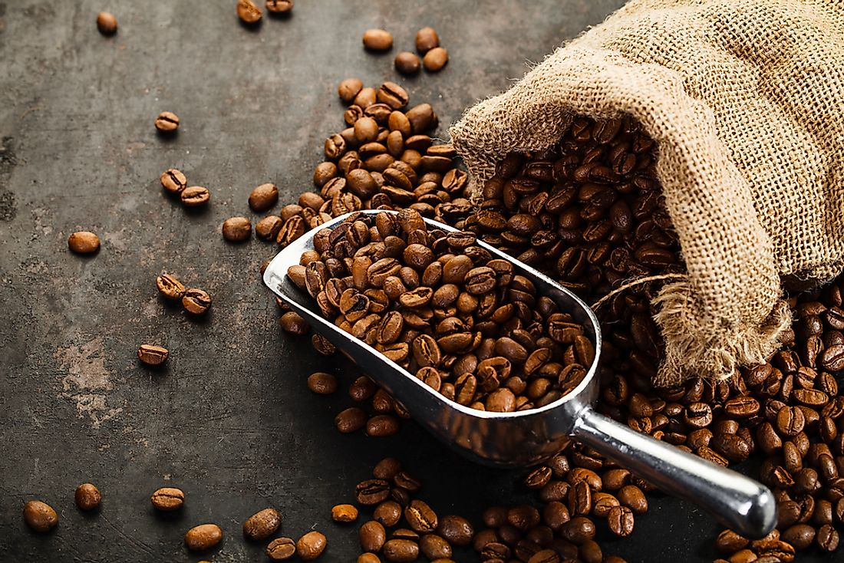
Module 4 · Video 3 · Profit Maximization of a Price Taker in the Short Run
Coffee Bean Producer
Your firm is a price taker in the coffee bean market
You have just optimized your output level for the short run
 | Your costs at that output
AVC | $12
ATC | $15
MC | $10
Should you continue to produce in the short run?
Poll Break
Management 405 · Module 4 · Competitive Markets and Market Interventions
45
Notes:
Your turn. A coffee bean producer, marginal cost of 10, average variable cost of 12, and a market price you can read off the slide. Decide what they should do before we work it through.

Slide 46
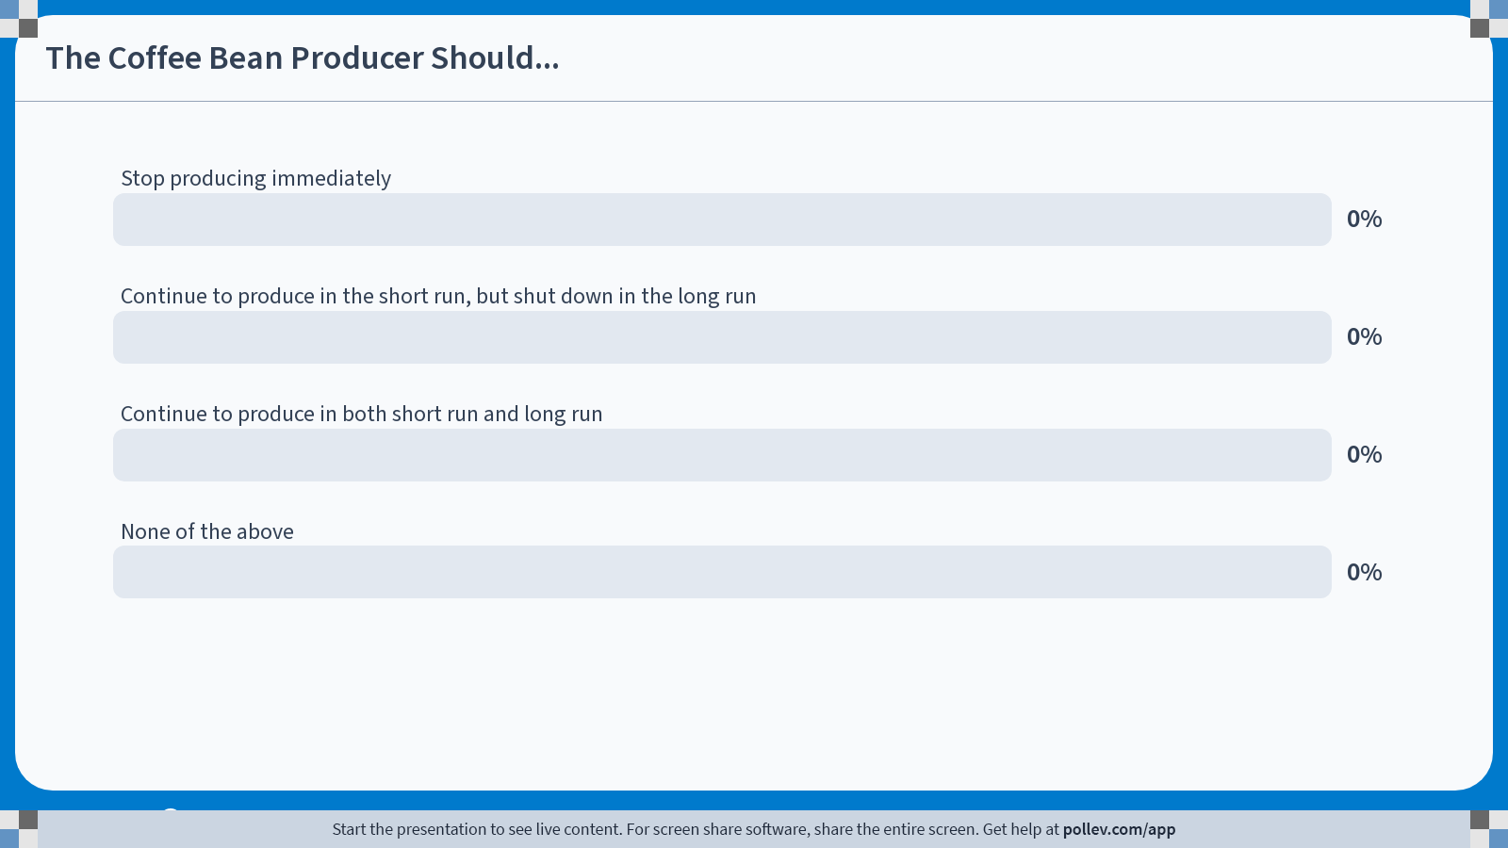
POLL
Notes:
Poll Title: Do not modify the notes in this section to avoid tampering with the Poll Everywhere activity. More info at polleverywhere.com/support The Coffee Bean Producer Should... https://www.polleverywhere.com/multiple_choice_polls/sry3DICjteteqyV1Ny4gL?state=opened&flow=Default&onscreen=persist

Slide 47
Module 4 · Video 3 · Profit Maximization of a Price Taker in the Short Run
Coffee Bean Producer: Solution
The output level is already profit-maximizing, so for a price taker P = MC
$$MC = 10 → P = 10$$
$$AVC = 12$$
$$Thus: P < AVC$$
$$You lose money on every unit — stop production$$
You will then continue to pay the fixed costs in the short run
— that minimizes the loss
Poll Break
Management 405 · Module 4 · Competitive Markets and Market Interventions
47
Notes:
The answer. The output level is already profit-maximising, because for a price taker marginal cost equals price - so price is 10. But average variable cost is 12, which means every unit sold loses money on its own variable cost. Stop production; the fixed costs still have to be paid, and that is the smaller loss.

Slide 48
Module 4 · Video 3 · Profit Maximization of a Price Taker in the Short Run
Summary: Short-Run Decisions for a Price Taker
$$Optimal output: Q^{∗} where MC = MR = P$$
If P ≥ AVC at Q*: continue to produce
Profits can still be positive or negative
Positive if P ≥ ATC, negative if P < ATC
If P < AVC at Q*: stop production
The loss is then TFC
Producing anyway would make the loss larger than TFC
✎ Problem Set 3
Management 405 · Module 4 · Competitive Markets and Market Interventions
48
Notes:
Everything from this section on one slide. Find the quantity where marginal cost equals price, then use the price-versus-AVC test to decide whether to produce at all. Problem Set 3 works through both steps on new numbers.

Slide 49
Firm-Level and Market Supply
Module 4 · Video 4
Management 405
Prof. Nico Voigtländer · UCLA Anderson

Slide 50
Module 4 · Video 4 · Agenda
Outline of Module 4
1
Introduction to Market Structures
Video 1
2
Perfect Competition
Video 2
2a
Profit Maximization of a Price Taker in the Short Run
Video 3
2b
Firm-Level and Market Supply
Marginal cost is one firm’s supply curve; market supply sums across firms
Video 4
2c
Long-Run Competitive Equilibrium
Video 5
3
Market Distortions and Regulations
In Class
4
Externalities
In Class
Management 405 · Module 4 · Competitive Markets and Market Interventions
50

Slide 51
Module 4 · Video 4 · Firm-Level and Market Supply
The MC Curve Is the Price Taker's Short-Run Supply Curve
The firm's cost curves
The firm's supply curve
Price ($)
Price ($)
MC
S
400
400
AVC
210
210
187.5
662.5
Q
187.5
662.5
q
The MC curve is the firm's short-run supply curve
🎬 Yi Family Example
Management 405 · Module 4 · Competitive Markets and Market Interventions
51
Notes:
A price taker’s supply curve. We can trace out the supply curve of the firm.
At P = 210, you maximize profits by producing 187.5 tons.
At P = 400, you expand more.
Bottom line: the MC curve is the firm’s short-run supply curve. We can draw the supply curve.

Slide 52
Module 4 · Video 4 · Firm-Level and Market Supply
The Effect of Changing Marginal Costs on a Price Taker's Supply
P
MC₀
MC₁
P = MR
High-yield seeds
reduce MC
q₀
q₁
q
Management 405 · Module 4 · Competitive Markets and Market Interventions
52
Notes:
Now change the firm's costs and watch what happens. High-yield seeds cut the marginal cost of every ton by the same amount, so the MC curve shifts down in parallel. At the unchanged market price the farmer's optimum moves out from q0 to q1 - lower costs mean more output, not just more profit per ton.
Example: the Yi family starts using new high-yield seeds

Slide 53
Module 4 · Video 4 · Firm-Level and Market Supply
Firm and Market Dynamics When MC Falls
Market
Firm (farmer)
P
P
MC₀
S₀
High-yield seeds
reduce MC
S₁
MC₁
P₀
MR₀ = P₀
P₁
MR₁ = P₁
Capital Q for market quantity
Small q for firm quantity
D
Q₀
Q₁
Q
q₀
q₂
q₁
q
If all firms’ costs fall, the market price falls too
Management 405 · Module 4 · Competitive Markets and Market Interventions
53
Notes:
Now assume every farmers are using those new high-yield seeds.
First, you see the effect on the individual farmer we just saw on the previous slide. However, because all farmers face lower costs, this changes the market supply: downward shift of the market supply curve, leading to a lower market price and higher aggregate quantity.
New market price = new demand curve for the individual farmer, so that the new quantity provided by the farmer is the intersection of this new D curve with the new MC curve (MC’ and MR’). The farmer produces more than before, but less than if he/she was the only one to have the new seeds (which would be the quantity given by the intersection of MC’ and MR)

Slide 54
Long-Run Competitive Equilibrium
Module 4 · Video 5
Management 405
Prof. Nico Voigtländer · UCLA Anderson

Slide 55
Module 4 · Video 5 · Agenda
Outline of Module 4
1
Introduction to Market Structures
Video 1
2
Perfect Competition
Video 2
2a
Profit Maximization of a Price Taker in the Short Run
Video 3
2b
Firm-Level and Market Supply
Video 4
2c
Long-Run Competitive Equilibrium
Entry and exit drive economic profits to zero
Video 5
3
Market Distortions and Regulations
In Class
4
Externalities
In Class
Management 405 · Module 4 · Competitive Markets and Market Interventions
55

Slide 56

Module 4 · Video 5 · Long-Run Competitive Equilibrium
Perfect Competition in the Long Run
What changes in the long run?
1. Capital can also be adjusted
All costs are considered variable
We thus focus on Long Run Average Costs (LAC)
2. Firms can enter and exit the market
Shifts the supply curve and thus affects the market price
Management 405 · Module 4 · Competitive Markets and Market Interventions
56
Notes:
Notes from the book: because all inputs and costs are variable in the long run, the firm’s long-run supply curve is the part of its long-run marginal cost curve above its long-run average total cost curve ( LATC=LAVC because there are no fixed costs in the long run).
Yi example: in the long run they can decide whether or not to rent the land + how much land to rent

Slide 57
Module 4 · Video 5 · Long-Run Competitive Equilibrium
Long-Run Competitive Equilibrium With Many Identical Producers
Competitive Markets: Large number of (actual and potential) firms that have the same cost structure and compete with each other
P
LMC
LAC
P₁
MR = P₁
Entry
P_{LR}
MR = P_{LR}
Exit
P₂
MR = P₂
Q₂
Q_{LR}
Q₁
Q
At Q_{LR}: P = LAC = LMC, and economic profit is zero
Management 405 · Module 4 · Competitive Markets and Market Interventions
57
Notes:
LAC is downward sloping because of economies of scale initially, and then upward-sloping because of dis-economies of scale. Note that this is different from ATC being down-ward sloping because of Fixed costs of a GIVEN technology.

Slide 58
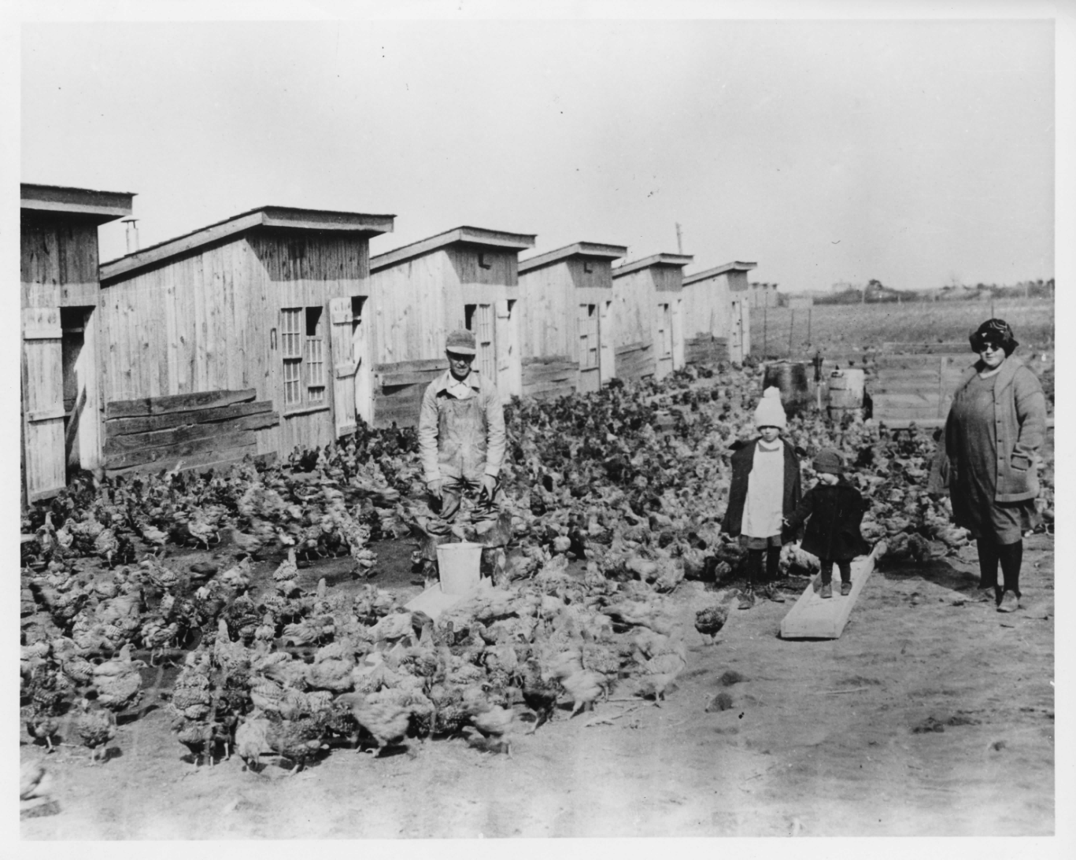
Module 4 · Video 5 · Long-Run Competitive Equilibrium
Entry Follows Profit: The Broiler Chicken Industry
In the 1920s the farmer Cecile Steele of Ocean View, Delaware kept a small flock of chickens for eggs
In 1923 she ordered 50 chicks and, by accident, received 500. She kept them and made a sizable profit
Word of her success spread, and by 1928 hundreds of farmers in the area were raising chickens for meat
An early Delaware broiler farm. Photo: Vox
Profit in a market with low entry barriers → new firms enter
Management 405 · Module 4 · Competitive Markets and Market Interventions
58
Notes:
Cecile Steele of Ocean View, Delaware ordered 50 chicks in 1923 and received 500 by mistake. She kept them, made a large profit, and within five years hundreds of neighbouring farmers were raising chickens for meat. That is entry in action - and it is why her extraordinary margins did not last.
https://www.vox.com/future-perfect/2023/2/10/23589333/cecile-steele-chicken-meat-poultry-eggs-delaware

Slide 59
Module 4 · Video 5 · Long-Run Competitive Equilibrium
Long-Run Equilibrium: The Drug Market
Can we use the toolbox on the market for illegal drugs?
Assume individual dealers are price takers
The government has two one-time options:
1
Arrest the drug dealers
2
Arrest or punish the drug users
Which policy does more to reduce the use of illegal drugs?
Management 405 · Module 4 · Competitive Markets and Market Interventions
59
Notes:
Now the toolbox goes somewhere less comfortable. Treat individual drug dealers as price takers in a competitive market, and the entry-and-exit logic we just built tells you what happens when policy targets sellers rather than buyers. The two slides that follow work through each case.
Can we characterize the drug market as a “constant cost industry?” → Yes.
Fixed cost: gun, car…
Variable cost: drugs
Same for each dealer

Slide 60
Module 4 · Video 5 · Long-Run Competitive Equilibrium
POLL
Management 405 · Module 4 · Competitive Markets and Market Interventions
60

Slide 61
Module 4 · Video 5 · Long-Run Competitive Equilibrium
Arrest Drug Dealers
Management 405 · Module 4 · Competitive Markets and Market Interventions
61
Notes:
Arresting dealers raises the cost of supplying, which shifts supply back. Quantity falls, but the price rises - so revenue in the market can easily go UP, and the surviving dealers make more per unit. That is the uncomfortable arithmetic behind supply-side enforcement.
SR effect: More drugs supplied by remaining dealers at higher P. Profits!
LR effect: Entry → Return to old equilibrium.

Slide 62
Module 4 · Video 5 · Long-Run Competitive Equilibrium
Arrest / Punish Drug Users
Management 405 · Module 4 · Competitive Markets and Market Interventions
62
Notes:
Going after users works on the other side of the market. Demand shifts back, so both quantity and price fall. Dealers make less, and the trade shrinks on both counts - which is why economists generally favour demand-side policy here.
SR effect: Less drugs supplied by each dealer. Loss!
LR effect: Exit → Converge to new equilibrium with less drugs consumed!

Slide 63
Module 4 · Video 5 · Long-Run Competitive Equilibrium
Summary: Long-Run Decisions for a Price Taker
$$Optimal output: Q^{∗} where LMC = MR = P$$
If P ≥ LAC at Q*: stay in the industry
Positive profits attract entry in the long run
If P < LAC at Q*: exit, or never enter
Losses cannot be sustained once capital is adjustable
Long-run competitive equilibrium: LMC = P = LAC “Normal profits” — economic profit is zero in the long run
Management 405 · Module 4 · Competitive Markets and Market Interventions
63
Notes:
The long-run rules in one place. Optimal output is still where marginal cost meets price, but now the comparison is with LONG-RUN average cost, because capital is adjustable. If price cannot cover LAC the firm exits, and entry and exit push the market to the point where economic profit is zero.

Slide 64
Module 4 · Agenda
Outline of Module 4
1
Introduction to Market Structures
Video 1
2
Perfect Competition
Video 2
2a
Profit Maximization of a Price Taker in the Short Run
Video 3
2b
Firm-Level and Market Supply
Video 4
2c
Long-Run Competitive Equilibrium
Video 5
3
Market Distortions and Regulations
Who wins, who loses, and what is lost outright
In Class
4
Externalities
In Class
Management 405 · Module 4 · Competitive Markets and Market Interventions
64

Slide 65
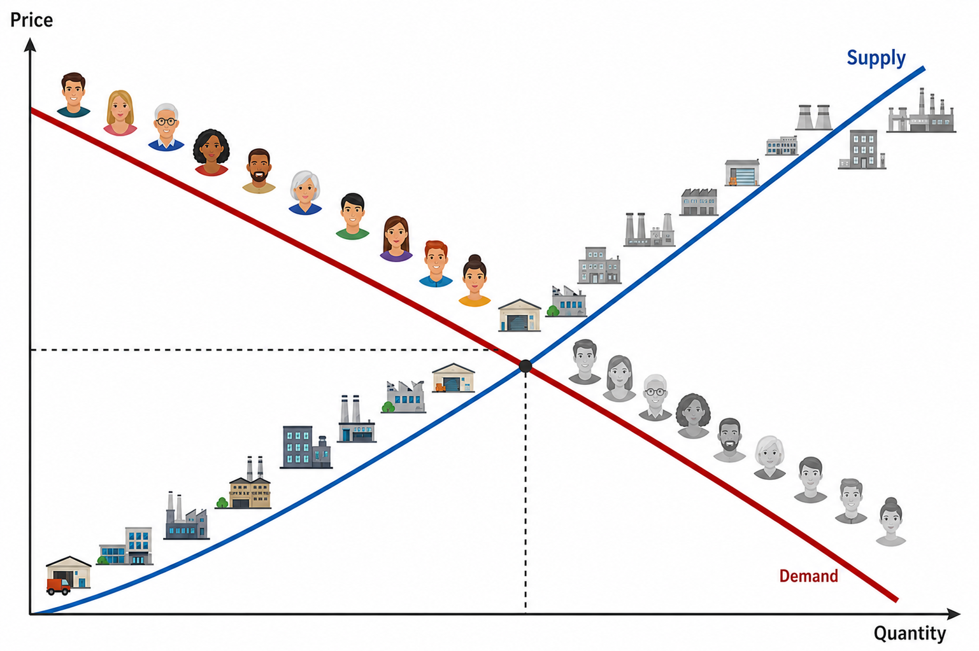
Module 4 · Market Distortions and Regulations
Welfare in a Market Economy and Distortions: Introduction
In a competitive market, equilibrium is where supply meets demand
Outside forces can push the market away from it
Price controls — rent control, minimum wages
Taxes and subsidies
How do we tell who gains and who loses?
Consumer and producer surplus
Deadweight loss
A competitive market with many consumers and producers
Management 405 · Module 4 · Competitive Markets and Market Interventions
65
Notes:
This section is about what happens when something pushes a market away from its competitive equilibrium - price controls, taxes, subsidies. The tools we need are consumer surplus, producer surplus and deadweight loss, and the next three slides build them.

Slide 66
Module 4 · Market Distortions and Regulations
Consumer Surplus
CS: the gap between what consumers would pay (the D curve) and what they do pay (P*)
P
S
Consumer surplus (CS) is the area below the demand curve and above the price line
What buyers were willing to pay, less what they actually paid
CS
P*
D
Q*
Q
Management 405 · Module 4 · Competitive Markets and Market Interventions
66
Notes:
Price consumers would be willing to pay = MPV we have seen in Module 2
We can tell them to check in the textbook how to compute CS from the demand curve (triangle area) + that it will be covered by the TA

Slide 67
Module 4 · Market Distortions and Regulations
Producer Surplus
PS: the gap between the price at which producers would sell (the S curve) and what they do receive (P*)
P
S
Producer surplus (PS) is the area above the supply curve and below the price line
What sellers received, less the least they would have accepted
P*
PS
D
Q*
Q
Management 405 · Module 4 · Competitive Markets and Market Interventions
67
Notes:
In this example PS>CS but it all depends on the relative steepness of the D and S curves
Willingness to sell depends on the producer cost structure

Slide 68


Module 4 · Market Distortions and Regulations
Market Distortions: Deadweight Loss
The inefficiency that a market intervention creates
Mutually beneficial transactions that no longer happen
Workers willing to work at the market wage and firms willing to hire them — but a minimum wage stands in the way
$$Deadweight loss = {Welfare}_{free market} − {Welfare}_{regulation}$$
$$with Welfare = CS + PS$$
Management 405 · Module 4 · Competitive Markets and Market Interventions
68
Notes:
Deadweight loss is the value that simply disappears - trades that both sides would have been happy to make, which the intervention prevents. It is the difference between total welfare in the free market and total welfare under the regulation, where welfare means consumer surplus plus producer surplus.

Slide 69
Module 4 · Market Distortions and Regulations
Sales Tax: a 10 % Tax on Top of the Listed Price
P
S’
Price received by the seller (P_{S}) drops.
Total price paid by the buyer (P_{B}, inclusive of tax) increases, but by less than the tax.
S
tax (t)
The buyers lose A + B
P_{B}
A
B
The sellers lose C + D
P_{B} − P_{S} = t
P₀
D
C
P_{S}
Deadweight loss: B + D
The government gets A + C
Taxes on some goods (e.g. cigarettes, gasoline…) can still make sense due to externalities (more below)
D
Q₁
Q₀
Q
✎ Problem Set 3
Management 405 · Module 4 · Competitive Markets and Market Interventions
69
Notes:
Example: gasoline
The welfare losses and incidence (who pays the tax) depends on elasticities of demand and supply. For example, if supply is perfectly elastic (the supply curve is horizontal), all of the tax is paid by the consumers.
The analysis of a subsidy is similar, except the demand (or supply) curve will shift outward.

Slide 70
Module 4 · Market Distortions and Regulations
Tax Incidence: Who Really Pays?
Tax incidence: which side of the market — buyers or sellers — ends up bearing the burden of the tax
Who hands the money to the government does not matter
The incidence is the same whether the tax is collected from the buyer or from the seller
What matters is the elasticity of supply and demand
The side that responds less to price bears more of the tax
The less price-responsive side of the market pays the larger share
Management 405 · Module 4 · Competitive Markets and Market Interventions
70
Notes:
Here is the point that surprises most people. It does not matter which side of the market physically hands the money to the government - the burden splits the same way either way. What determines the split is elasticity: whichever side responds less to price ends up paying more of the tax.

Slide 71
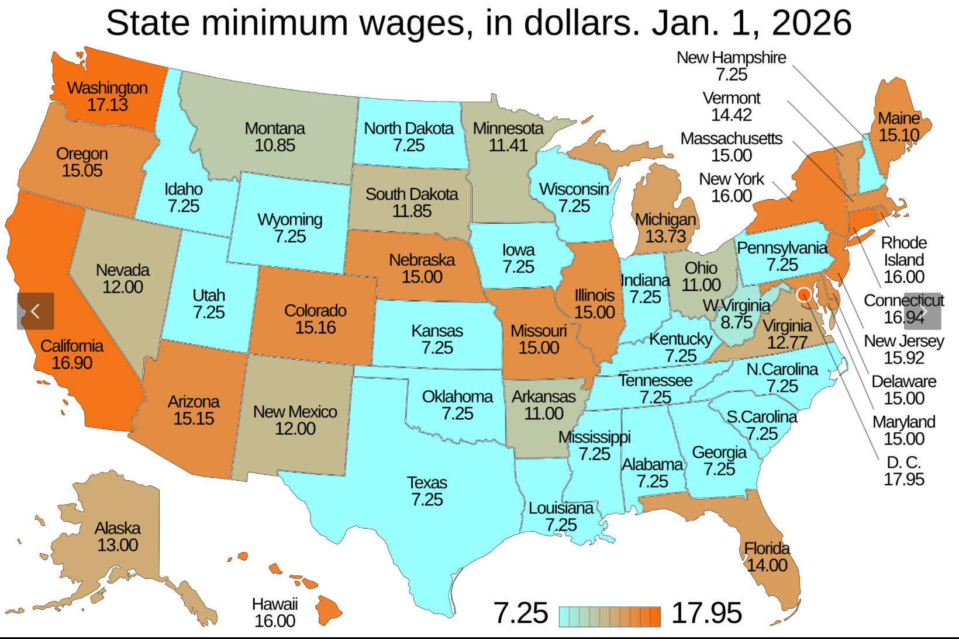
Module 4 · Market Distortions and Regulations
The Minimum Wage: A Popular Policy Tool
Source: Wikipedia / US Department of Labor
Management 405 · Module 4 · Competitive Markets and Market Interventions
71
Notes:
Before the theory, some context. Minimum wages are one of the most widely used price floors in the world, and the map shows how much the level varies across US states. Keep that variation in mind - it is what makes the empirical evidence possible.

Slide 72
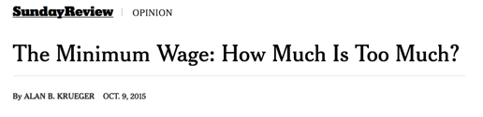
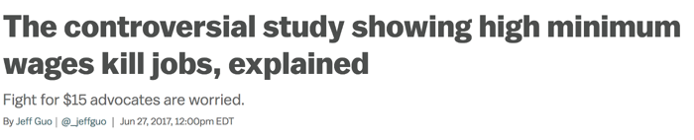
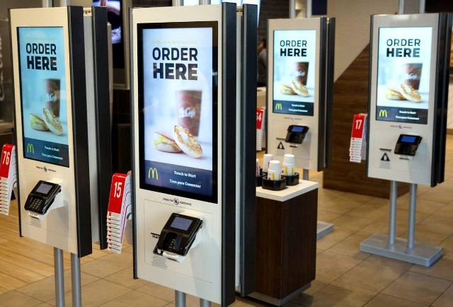
Module 4 · Market Distortions and Regulations
Podcast: What Does the Evidence Say on the Minimum Wage?
What is the expected effect of raising the minimum wage on employment?
According to economic theory: Negative
Evidence: Mixed results
Employment does not seem to decline, BUT:
Hours worked decline (Seattle study)
Experienced workers: moderate decline in hours, so total income ↑
Low-skilled, inexperienced workers: substantial decline in hours and thus income ↓
New workers: harder to find first job
What are possible long-run effects of a (high) minimum wage?
One way firms respond to a higher wage floor
Management 405 · Module 4 · Competitive Markets and Market Interventions
72
Notes:
This is the podcast slide. The theory says a minimum wage should reduce employment, but the evidence is genuinely mixed: employment itself often does not fall much, while hours worked do. Listen for the distinction between experienced workers, whose total income can still rise, and low-skilled or new entrants, who tend to lose on both counts.
https://www.epi.org/minimum-wage-tracker/

Slide 73
Module 4 · Market Distortions and Regulations
Price Floor: The Minimum Wage
Wage
S_{Labor}
Welfare effects
Some workers win A — they are paid more
Some workers lose C — they are not hired
Firms lose A + B
w_{min}
A
B
Deadweight loss: B + C
w*
C
Circumvention of minimum wages?
Underground labor market
Cutting non-wage benefits
Unpaid internships
D_{Labor}
L_{D}
L*
L_{S}
Labor
L_{S} − L_{D} = unemployment
Management 405 · Module 4 · Competitive Markets and Market Interventions
73
Notes:
The minimum wage as a price floor. Set above the market wage, it raises the wage for those who keep their jobs (area A), but firms hire fewer workers, so some who would have worked do not (area C). The gap between labour supplied and labour demanded at the floor is unemployment, and B plus C is the deadweight loss.

Slide 74
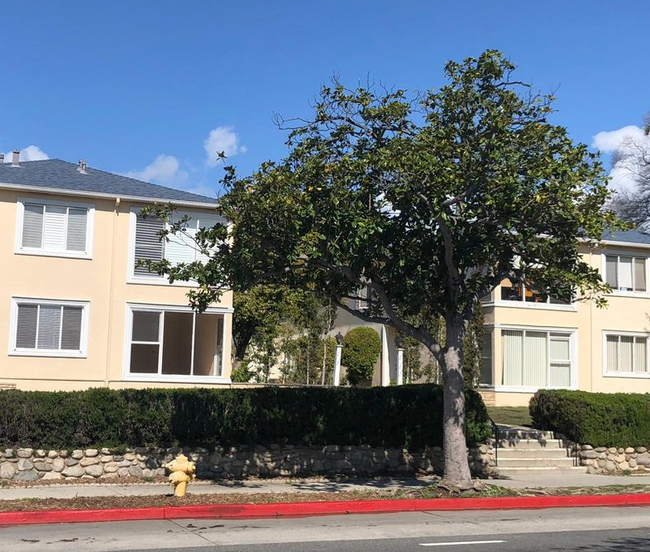
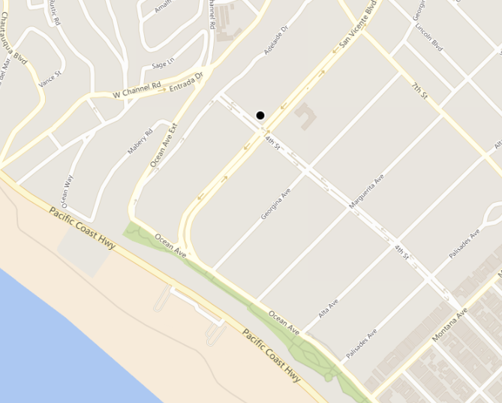
Module 4 · Market Distortions and Regulations
Guess the Rent!
1 bed, 1 bath
900 sqft
401 San Vicente Blvd., Santa Monica
5-minute walk to the beach
Best public school district in West LA
Poll Break
Management 405 · Module 4 · Competitive Markets and Market Interventions
74
Notes:
Before we do rent control, a quick calibration exercise. Look at the flat, the location and the map, and write down what you think it rents for. Hold your number - the answer on the next slide is usually a surprise.

Slide 75
Module 4 · Market Distortions and Regulations
POLL
Management 405 · Module 4 · Competitive Markets and Market Interventions
75

Slide 76
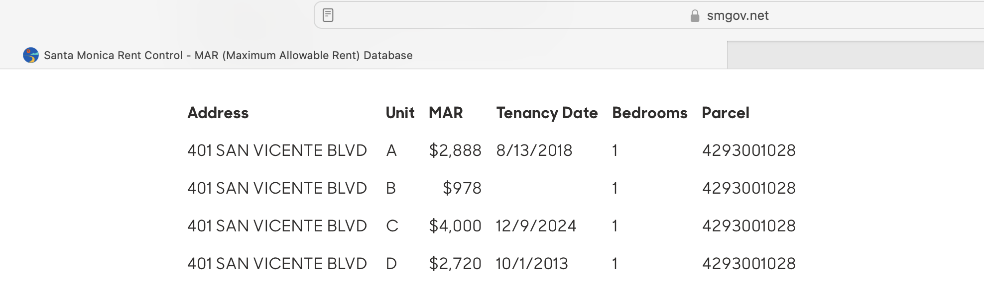
Module 4 · Market Distortions and Regulations
The Rent Is…
Poll Break
Management 405 · Module 4 · Competitive Markets and Market Interventions
76
Notes:
Here is the answer. The unit is rent-controlled, and the Maximum Allowable Rent on the city's own database is far below what the neighbouring units fetch. That gap between the controlled rent and the market rent is the whole subject of the next few slides.
https://www.smgov.net/departments/rentcontrol/mar.aspx

Slide 77
Module 4 · Market Distortions and Regulations
Price Ceiling: Rent Control
P
Welfare effects
S
Some renters win A — those who keep a place
Some renters lose B — they cannot find one
Landlords lose A + C
P*
B
C
Deadweight loss: B + C
A
P_{max}
D
Q_{S}
Q*
Q_{D}
Q
Q_{D} − Q_{S} = shortage
Management 405 · Module 4 · Competitive Markets and Market Interventions
77
Notes:
Rent control is the mirror image: a ceiling below the market price. Renters lucky enough to hold a place gain (area A), but landlords list fewer flats, so the quantity supplied falls and a shortage opens up between what renters want and what is offered. B plus C is again the deadweight loss.

Slide 78
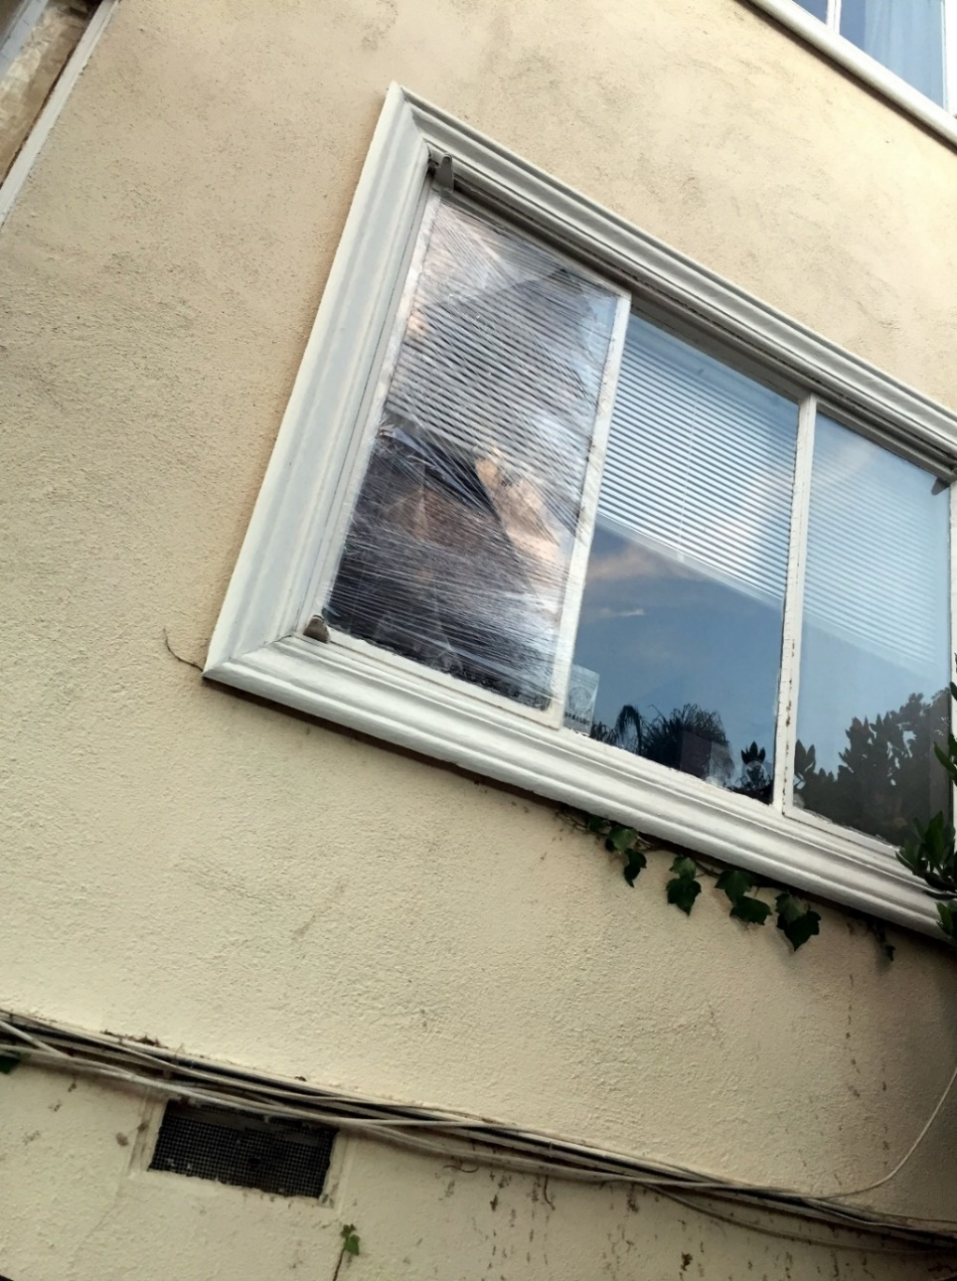

Module 4 · Market Distortions and Regulations
How Do Landlords React to Rent Control?
Non-price adjustments (e.g. neglect maintenance)
Buy the tenants out (legal)
Harass the tenants (illegal)
Management 405 · Module 4 · Competitive Markets and Market Interventions
78
Notes:
Price is not the only thing landlords can adjust. When they cannot raise the rent they can let maintenance slide, buy tenants out, or - illegally - make life unpleasant enough that people leave. The photographs are from rent-controlled buildings in Santa Monica.

Slide 79

Module 4 · Market Distortions and Regulations
Evidence on Rent Control: Cambridge, MA
A natural experiment: rent control in Cambridge ended suddenly in 1995
Source: Autor, Palmer and Pathak (2014)
Management 405 · Module 4 · Competitive Markets and Market Interventions
79
Notes:
The geography of residential properties and rent control in Cambridge, Massachusetts. Cambridge residential properties as of 2008 are marked with gray circles. Plots that were rent controlled as of 1994 are overlaid with black circles.
Source: Autor, Palmer and Pathak (2014), “Housing Market Spillovers: Evidence from the End of Rent Control in Cambridge, Massachusetts” — https://economics.mit.edu/files/9774

Slide 80
Module 4 · Market Distortions and Regulations
What Happened When Rent Control Ended?
“Natural” experiment: sudden end of rent control in Cambridge, MA in 1995
What do you think happened to:
Rental price for previously rent-controlled units?
Investment in previously rent-controlled units?
Price/investment for nearby never-controlled units?
Poll Break
Management 405 · Module 4 · Competitive Markets and Market Interventions
80
Notes:
Cambridge, Massachusetts gives us an unusually clean test. Rent control ended there suddenly in 1995, so we can compare what happened to controlled units against never-controlled units nearby. Think about your prediction for each of the three questions before we look.

Slide 81
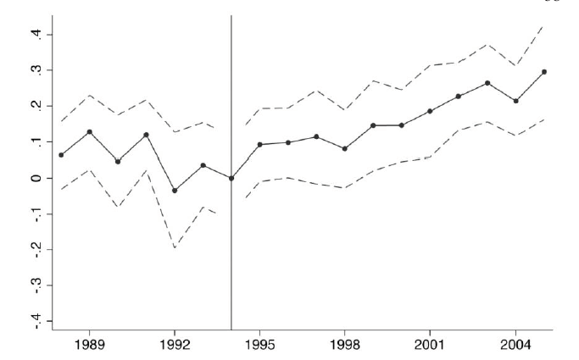
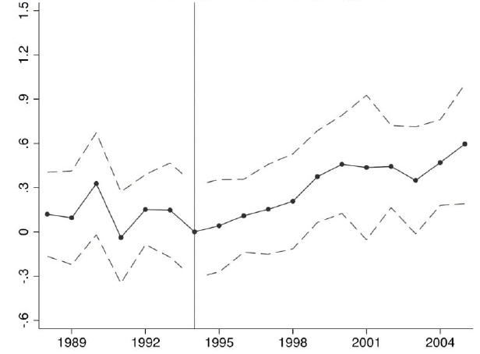
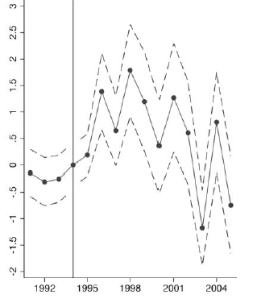
Module 4 · Market Distortions and Regulations
Evidence on Rent Control: Results
Impact on the price of never-controlled units
Impact on investment activities at decontrolled units ($1000s)
Impact on the price of decontrolled units
Rents rose, and so did investment — including at the units next door
Management 405 · Module 4 · Competitive Markets and Market Interventions
81
Notes:
The results. Rents rose sharply at the decontrolled units, as you would expect - but they also rose at units nearby that were never controlled, and investment went up at both. The spillover is the surprising part: rent control was holding down the value of the whole neighbourhood, not just the controlled flats.
Source of all three panels: Autor, Palmer and Pathak (2014), “Housing Market Spillovers: Evidence from the End of Rent Control in Cambridge, Massachusetts”.

Slide 82

Module 4 · Market Distortions and Regulations
Argentina Scrapped Its Rent Controls
Argentina repealed its rent-control law at the end of 2023
Reported since: many more flats listed, and rents lower in real terms
Not everyone gains — sitting tenants lost their protection
Management 405 · Module 4 · Competitive Markets and Market Interventions
82
Notes:
Magnitudes are as reported in the press, not from a study. Source: The Wall Street Journal, “Argentina Scrapped Its Rent Controls. Now the Market Is Thriving.”

Slide 83
Module 4 · Agenda
Outline of Module 4
1
Introduction to Market Structures
Video 1
2
Perfect Competition
Video 2
2a
Profit Maximization of a Price Taker in the Short Run
Video 3
2b
Firm-Level and Market Supply
Video 4
2c
Long-Run Competitive Equilibrium
Video 5
3
Market Distortions and Regulations
In Class
4
Externalities
Costs and benefits that land on people outside the deal
In Class
Management 405 · Module 4 · Competitive Markets and Market Interventions
83

Slide 84
Module 4 · Externalities
Externalities: Definitions
Externality: A cost or a benefit that falls on someone who is not part of the transaction
Negative externality — A cost imposed on an outsider
Air pollution from coal-fired power plants
The external cost of gasoline is about $1.50 per gallon
Positive externality — A benefit conferred on an outsider
Your neighbor's well-kept front yard is a pleasure for you to look at too
Management 405 · Module 4 · Competitive Markets and Market Interventions
84
Notes:
The definitions we need. An externality is a cost or a benefit that lands on someone who is not part of the transaction - pollution from a power plant on one side, a well-kept front yard on the other. The gasoline number on this slide, about $1.50 a gallon in external cost, is the one we use in the worked example.

Slide 85

Module 4 · Externalities
Correcting for Externalities
The aim of the intervention: move the market toward the quantity that would be chosen if the outside cost or benefit were counted
Price mechanisms: taxes and subsidies
Tax the activity that imposes the cost, subsidize the one that confers the benefit
Quantity mechanisms: quotas and mandates
Negative externality — cap it: a limit on the tonnes of sulphur dioxide a power plant may emit in a year
Positive externality — require it: childhood vaccination as a condition of school entry
Management 405 · Module 4 · Competitive Markets and Market Interventions
85
Notes:
Two families of fix. Price mechanisms - a tax on the harm or a subsidy for the benefit - change what the decision-maker faces and let the market find the quantity. Quantity mechanisms - quotas, standards, outright bans - set the quantity directly. Each has its place, and the next slides work through the price route.

Slide 86
Module 4 · Externalities
The Externality: Gasoline
$ / gallon
Social marginal cost SMC = MC_{I} + EMC
EMC = $1.50 per gallon
Supply = internal marginal cost (MC_{I})
P_{Ext}
P_{Market}
Drivers weigh only their own cost, so the market settles at Q_{Market}. Counting the cost borne by everyone else, the efficient quantity is the smaller Q_{Ext}.
Demand
1.5
External marginal cost (EMC)
Q_{Ext}
Q_{Market}
Gallons of gasoline per year
Management 405 · Module 4 · Competitive Markets and Market Interventions
86
Notes:
Here is the wedge. Drivers weigh only their own cost of a gallon, so the market settles where demand meets private marginal cost. Add the external cost that everyone else bears and the socially efficient quantity is smaller. The gap between the two supply curves is the external marginal cost - about $1.50 a gallon.

Slide 87
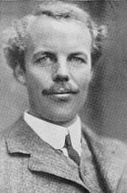
Module 4 · Externalities
A Carbon Tax to Correct the Negative Externality
$ / gallon
Social marginal cost SMC = MC_{I} + EMC
Tax = EMC = $1.50
Supply = internal marginal cost (MC_{I})
P_{E}^{C}
P_{Market}
Arthur Pigou
P_{E}^{P}
Demand
A tax equal to the external cost makes each driver face the social marginal cost, and the market lands on Q_{Ext} on its own.
1.5
External marginal cost (EMC)
Q_{Ext}
Q_{Market}
Gallons of gasoline per year
P_{E}^{C} : Price paid by consumer with tax on externality
P_{E}^{P} : Price received by producer with tax on externality
Management 405 · Module 4 · Competitive Markets and Market Interventions
87
Notes:
Externality of gas is approx $1.5 per gallon: https://energyathaas.wordpress.com/2015/01/05/raise-the-gas-tax/
77 countries have committed to achieving net zero emissions by 2050
Half of emissions cuts must be in place by 2030 to keep warming below 1.5°C
Carbon taxes have been implemented (or scheduled) in 46 countries
$44 billion raised in carbon pricing revenues in 2018
But this is not enough
Covers only 20% of emissions
No carbon tax in the US nor in China…
Incentives for Coal countries to burn their coal even faster now, before regulation goes into effect
Other ways of limiting emissions?

Slide 88

Module 4 · Externalities
Externality: Airplane Noise
Noise contours around Santa Monica Airport
Management 405 · Module 4 · Competitive Markets and Market Interventions
88
Notes:
Airport noise is the same problem in a form you can hear. Every flight in and out of Santa Monica imposes a cost on the neighbourhood that the pilot does not pay, and the article shows how sharply the community has pushed back.

Slide 89
Module 4 · Externalities
A Pigouvian Tax for Noise? The Case of Santa Monica Airport
Price
“Corner solution” with Q* = 0 → shut down the airport
MC_{I} + tax = SMC (social marginal cost)
Noise pollution (EMC)
Noise tax = EMC
Pilots' internal MC_{I} of flying
D (MB of flying)
Q* = 0
Q_{current}
Flights per day
SMC lies above willingness to pay at every quantity — a corner solution at Q* = 0, so close the airport
Management 405 · Module 4 · Competitive Markets and Market Interventions
89
Notes:
And here is where the arithmetic gets uncomfortable. Add the noise cost to the pilots' own cost and social marginal cost lies above willingness to pay at EVERY quantity - so the efficient number of flights is zero. This is a corner solution, and in Santa Monica it is close to what actually happened.

Slide 90
Module 4 · Summary
Module 4: Summary
Perfect competition: the firm is a price taker, so MR = P
Profit maximization: MC = MR = P gives Q*
The decision to produce in the short run
Continue to produce if P ≥ AVC; stop production if P < AVC
The decision to stay in the industry in the long run
Stay if P ≥ LAC; exit or never enter if P < LAC
Long-run equilibrium: P = LMC = LAC, so profit is zero
Market distortions: price controls and taxes
Winners, losers, and deadweight loss
Externalities, and the Pigouvian tax that corrects them
Management 405 · Module 4 · Competitive Markets and Market Interventions
90
Notes:
Pulling it together. In the short run a price taker produces where MC equals price and keeps going as long as price covers average variable cost. In the long run entry and exit compete profit away. And once we intervene - or once a cost lands on someone outside the transaction - surplus and deadweight loss are how we judge who gains and who loses.

Slide 91
Slides Not Included
in the Videos
Management 405 · Module 4 · Competitive Markets and Market Interventions
91

Slide 92
Module 4 · Video 1 · Logistics
Some Logistics
Coffee & Econ office hours restart next week
Final exam period: December 11 – 13, 2026
One 3.5-hour window — the same window for everyone
The exact date and time will be announced later
Online, open book, open notes; covers all material
Management 405 · Module 4 · Competitive Markets and Market Interventions
92
Notes:
A few housekeeping points before we start. The problem set for this module is on BruinLearn, and the practice videos are there too. Everything we do today builds on the cost curves from Module 3, so keep those handy.

Slide 93
Module 4 · Video 3 · Profit Maximization of a Price Taker in the Short Run
Relationship to Accounting: Ross Stores Annual Report
 | Economic cost concept | Year ended Jan 29, 2022 | Year ended Jan 30, 2021
Sales |  | 18,916,244 | 12,531,565
Cost of goods sold | ≈ TVC | 13,708,907 | 9,838,574
Selling, general and administrative | Mix of FC & VC | 2,874,469 | 2,503,281
Interest expense (income), net | Part of FC | 74,328 | 83,413
Total costs and expenses | ≈ TC | 16,657,704 | 12,425,268
Ross Stores, Form 10-K, fiscal 2021 · $ thousands
Accounting costs leave out opportunity costs
Management 405 · Module 4 · Competitive Markets and Market Interventions
93
Notes:
Using Ross Stores Annual report for illustration: https://www.sec.gov/ix?doc=/Archives/edgar/data/745732/000074573222000014/rost-20220129.htm#i84f0090916e6417881836bdad18ed609_64
Highlight the 3 items under “costs and expenses”
Costs of goods sold = variable
Selling, general and administrative = a bit of both (sales commissions would be variable but the CEO salary fixed)
Interest expense (the cost of borrowing money) = fixed

Slide 94
Module 4 · Video 3 · Profit Maximization of a Price Taker in the Short Run
POLL
Management 405 · Module 4 · Competitive Markets and Market Interventions
94

Slide 95
Module 4 · Video 3 · Profit Maximization of a Price Taker in the Short Run
POLL
Management 405 · Module 4 · Competitive Markets and Market Interventions
95

Slide 96
Module 4 · Video 3 · Profit Maximization of a Price Taker in the Short Run
POLL
Management 405 · Module 4 · Competitive Markets and Market Interventions
96

Slide 97
Module 4 · Video 5 · Long-Run Competitive Equilibrium
Long-Run Equilibrium: The Drug Market
Can we use the toolbox on the market for illegal drugs?
Assume individual dealers are price takers
The government has two one-time options:
1
Arrest the drug dealers
2
Arrest or punish the drug users
Which policy does more to reduce the use of illegal drugs?
Management 405 · Module 4 · Competitive Markets and Market Interventions
97
Notes:
Now the toolbox goes somewhere less comfortable. Treat individual drug dealers as price takers in a competitive market, and the entry-and-exit logic we just built tells you what happens when policy targets sellers rather than buyers. The two slides that follow work through each case.
Can we characterize the drug market as a “constant cost industry?” → Yes.
Fixed cost: gun, car…
Variable cost: drugs
Same for each dealer

Slide 98
Module 4 · Video 5 · Long-Run Competitive Equilibrium
POLL
Management 405 · Module 4 · Competitive Markets and Market Interventions
98

Slide 99
Module 4 · Video 5 · Long-Run Competitive Equilibrium
Arrest Drug Dealers
Management 405 · Module 4 · Competitive Markets and Market Interventions
99
Notes:
Arresting dealers raises the cost of supplying, which shifts supply back. Quantity falls, but the price rises - so revenue in the market can easily go UP, and the surviving dealers make more per unit. That is the uncomfortable arithmetic behind supply-side enforcement.
SR effect: More drugs supplied by remaining dealers at higher P. Profits!
LR effect: Entry → Return to old equilibrium.

Slide 100
Module 4 · Video 5 · Long-Run Competitive Equilibrium
Arrest / Punish Drug Users
Management 405 · Module 4 · Competitive Markets and Market Interventions
100
Notes:
Going after users works on the other side of the market. Demand shifts back, so both quantity and price fall. Dealers make less, and the trade shrinks on both counts - which is why economists generally favour demand-side policy here.
SR effect: Less drugs supplied by each dealer. Loss!
LR effect: Exit → Converge to new equilibrium with less drugs consumed!

Slide 101
Some Applications of the Material
Covered in Module 4, Videos 1 – 5
Management 405 · Module 4 · Competitive Markets and Market Interventions
101

